Slide 1
Research is Dope and other non-drug related things…
Dr. Erin Buchanan
Missouri State University

Slide 2
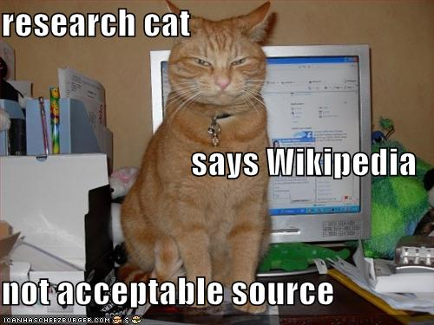

Slide 3
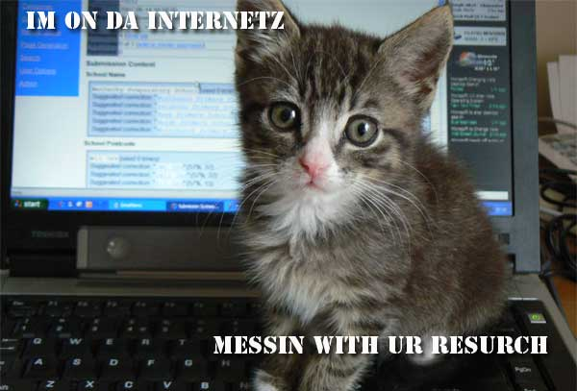
Research
According to Wikipedia ☺
  Research can be defined as the search for knowledge, or as any systematic investigation, with an open mind, to establish novel facts, solve new or existing problems, prove new ideas, or develop new theories.
According to lolcats:

Slide 4

Research
IS NOT
  That boring stuff you did in PSY 302 (sorry Drs. Fallone, Kostic, Rosenkoetter!).
  Test tubes and counting stuff.

Slide 5

Research
IS
  Varied – you can do research on nearly anything.
  Fascinating – don’t know the answer to a question? Test it!
  Work – but work that’s worth your time and effort.

Slide 6
research
A sample of what’s going on here at MSU:
  Values, distress, and academic achievement
  Educational applications of mnemonic learning strategies. Development and validation of implicit measures of attributes (attitudes and personality traits) of interest to organizations concerned about managing risks related to counterproductive behavior.
  Cognitive and intellectual measures related to ADHD symptoms in children.

Slide 7
Research
Yet even more cool stuff:
  The role of mental health professionals in the judicial setting; the
  prediction of future violent or aggressive behavior• Neurobehavioral assessment of infants and children; emotional regular in infancy and childhood; and prenatal drug exposure.
  Caregiving, women’s and men’s reactions to growing older within anti-aging Western beauty culture, impact of being overweight across life span, mother-daughter attachment, gerontology
  Functional leadership, team processes, goal setting, self-regulation
  Academic motivation and achievement, diversity issues within education, academic advising, and student success.

Slide 8
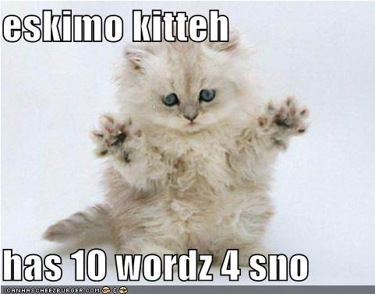
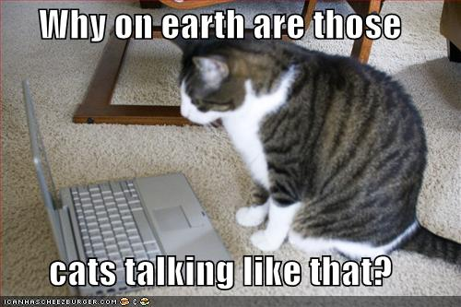
Research
All the really cool stuff

Slide 9
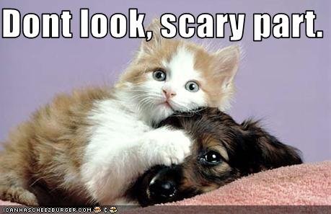
How to get involved
You have to
  Like
    Talk to faculty…

Slide 10
When to get involved
The earlier, the better.
  Gives you longer to get to know a faculty member.
  Gives you longer to work on projects (you get to see the end result!).
  Gives you time to work on your own projects.

Slide 11
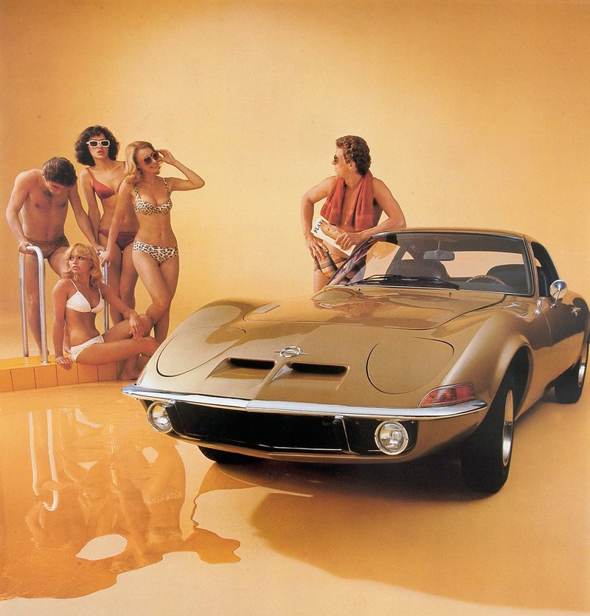
Why?
Graduate School
  It’s kind of a big deal.
  Gives your application a boost.
Letters of reference
  Even for jobs.
It’s cool stuff
Google search for cool stuff →

Slide 12
If you are involved
Get more involved – think of your own projects
Don’t sell yourself short on your vitas/resumes!

Slide 13
Erin’s cool research
(the rest is boring)
Associations = Family Feud study
Word Frequency = Facebook study

Slide 14


bake
skillet
beverage
tub
meal
spare
refrigerator
commercial
Score
Exit Game

Slide 15

FAMILY FEUD
Cake 40
1) X X X X X X
Cook 25
2) X X X X X X
Broil 5
3) X X X X X X
Fry 2
4) X X X X X X
X
X
X
Score
bake
Select
Category

Slide 16
FAMILY FEUD
DINOSAUR 43
1) X X X X X X
Drink 49
FOSSIL 21
2) X X X X X X
Soda 29
SHELLS 12
3) X X X X X X
Beer 7
JARASSIC 13
4) X X X X X X
Water 2
X
X
X
Score
Select
Category
beverage

Slide 17
FAMILY FEUD
DINOSAUR 43
1) X X X X X X
Food 49
EONS 5
5) X X X X X X
Ticket 2
FOSSIL 21
2) X X X X X X
Dinner 21
SHELLS 12
3) X X X X X X
Lunch 6
JARASSIC 13
4) X X X X X X
Supper 6
X
X
X
Score
meal
Select
Category

Slide 18
FAMILY FEUD
DINOSAUR 43
1) X X X X X X
Food 42
FOSSIL 21
2) X X X X X X
Cold 27
SHELLS 12
3) X X X X X X
Freezer 12
JARASSIC 13
4) X X X X X X
Cool 5
X
X
X
Score
Select
Category
refrigerator

Slide 19
FAMILY FEUD
DINOSAUR 43
1) X X X X X X
Pan 48
FOSSIL 21
2) X X X X X X
Fry 24
SHELLS 12
3) X X X X X X
Egg 10
JARASSIC 13
4) X X X X X X
Cook 5
X
X
X
Score
skillet
Select
Category

Slide 20
FAMILY FEUD
DINOSAUR 43
1) X X X X X X
Bath 49
EONS 5
5) X X X X X X
Bathroom 3
FOSSIL 21
2) X X X X X X
Water 22
SHELLS 12
3) X X X X X X
Shower 4
JARASSIC 13
4) X X X X X X
Sink 4
X
X
X
Score
tub
Select
Category

Slide 21
FAMILY FEUD
DINOSAUR 43
1) X X X X X X
Tire 42
EONS 5
5) X X X X X X
Time 3
FOSSIL 21
2) X X X X X X
Extra 27
PERIOD 3
6) X X X X X X
Save 3
SHELLS 12
3) X X X X X X
Rib 3
JARASSIC 13
4) X X X X X X
Change 3
X
X
X
Score
spare
Select
Category

Slide 22
FAMILY FEUD
DINOSAUR 43
1) X X X X X X
Television 41
FOSSIL 21
2) X X X X X X
Advertisement 20
SHELLS 12
3) X X X X X X
Business 3
JARASSIC 13
4) X X X X X X
Food 3
X
X
X
Score
Select
Category
commercial

Slide 23
Results

Slide 24
Updating your Status
How Facebook Talk Informs Us About Current Word Use

Slide 25
Updating your Status
How Facebook Talk Informs Us About Current Word Use

Slide 26
the Facebook
600 million users
Started at Harvard
  2004 as a company
  2005 bought facebook.com domain

Slide 27
the Facebook
3rd largest web company
  After google.com and amazon.com
In March 2010, had more hits than google.com

Slide 28
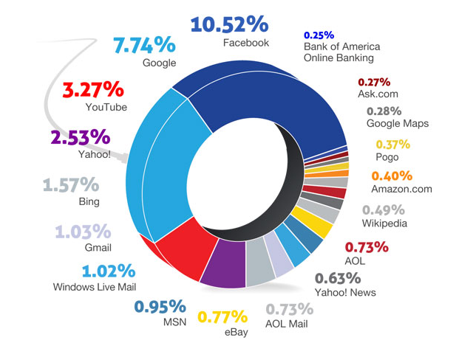

Slide 29

the Facebook
Word Use
  Facebooking, Facebook – 2008
  Unfriend – 2009
The Social Network - 2010

Slide 30
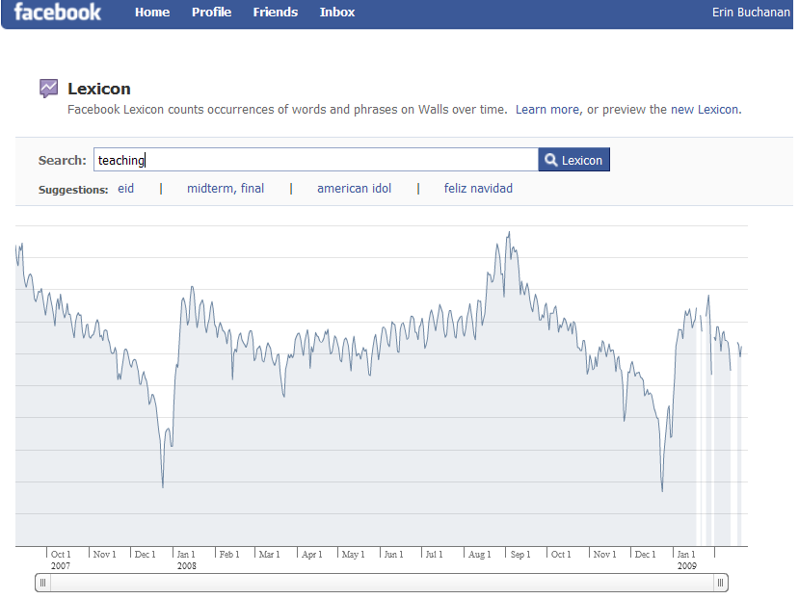

Slide 31
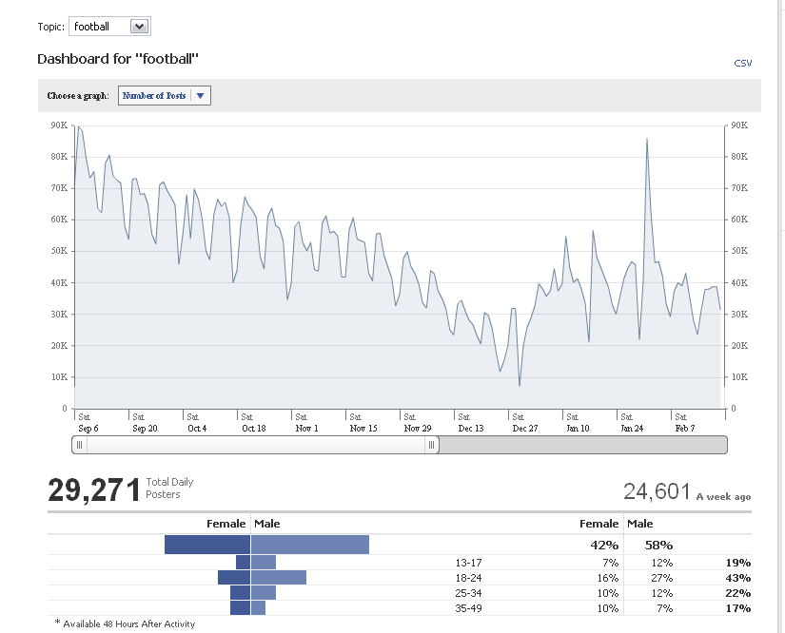

Slide 32
Previous Research
Frequency
  Simple word counts – how often words appear in written text.
  HAL – Hyperspace Analogue to Language (Burgess & Lund, 1997)
  Brown Corpus (Kucera & Francis, 1967)
  Google ngrams (Google.com, 2011)
  Many more….

Slide 33
Current Study
Status Updates
  2004 to present
  Over 2 Gigs of text information
  700+ Facebook walls

Slide 34
Current Study
Each Facebook wall is reduced to posts and statuses
  Then each timestamp is tagged with the status.
    just loves being at work 3 hours after the store closes. Timestamp: Monday, March 29, 2010 at 1:31am
    VEGAS BABY!!!!! Timestamp: Monday, February 1, 2010 at 12:47am
    Flu shot: shot. Hannah Montana band-aid: stuck. Bam. Ready to roll. :) Timestamp: Wednesday, October 27, 2010 at 3:09pm
    Pshhhhh. Timestamp: Saturday, July 11, 2009 at 12:01pm

Slide 35
Current Study
Word Use
  Nearly 40,000 unique words were collected
  Frequency was counted over all words
    Time values to be added later for comparison
  Only words with information in at least one frequency database are used here.
    For example, lol omg are all excluded because they were not in the databases for text word frequency.

Slide 36
Most Common Words
What do you think the most common words are?

Slide 37
Most Common Words
 | Brown Corpus | HAL | Facebook
1 | a | the | I
2 | in | to | you
3 | he | of | to
4 | be | and | the
5 | I | a | a
6 | have | in | and
7 | one | is | is
8 | there | that | it
9 | who | you | in
10 | will | for | my

Slide 38
Results - Overlap
Facebook
HAL
49%
Facebook
Brown
40%

Slide 39
Results – Overlap
There appears to only be a 40-50% overlap between our social word use (hey!) and written word use (Hello.)
  What is the rest?
Most common word uses are still similar
  Pronouns
  Verbs
  Determinants
  Prepositions

Slide 40
Results – Common Uses
There are several social implications from the top 100 words:
  Happy Birthday = 11 and 15
  Love = 26
  Miss = 34
  Hey = 39
  Class = 51
  Haha = 53

Slide 41
Results – So what?
What does this mean for everyday language?
  Language is always changing and evolving – words are deleted and added to the dictionary yearly.
  Over time languages tend to condense – we use less words to emphasize the same meaning.

Slide 42
Questions!

